Slide 1





The MCA
Flightline
Newsletter of the Music City Aviators
Volume 11
Issue 6
June 2018
AMA Chapter #494 - www.MusicCityAviators.org
In This Issue…
Do you know of someone who would like to learn to fly Radio Control? Our club has a top of the line trainer and several even better pilots who can train them. Have them make the call to John Forehand.
Upcoming R/C Events
June Mtg Minutes
Member Moments
(lots of events = lots of pics)
Time To Renew with MCA
July Meeting
Have you renewed your MCA membership for 2018? There’s 2 easy ways you can pay your dues:
1.) Come to a meeting and pay in person.
2.) Pay online at our website. There is a link to pay via PayPal on the Club Info page.
Don’t forget to renew your AMA and Metro Park Permit too!
Next meeting - July 17th – 6:30 PM
Music City Aviators Monthly Meeting
to be held at our field at Peeler Park.
Check out the new internet home of the Music City Aviators!
www.MusicCityAviators.org

Slide 2



The MCA
Flightline
Points Of Interest
Upcoming R/C Events
Part of the fun in our Hobby is attending special events hosted by various local clubs. Check out the upcoming events listed below and make an effort to attend as many as you can. Additional information can be found in this month’s minutes
Date Event Club
June 23 Float Fly-in at Poole's Knob MTRCS.
June 27 OFD w/fun competition MCA
July 10-11 Society of Antique Modelers SAM
July 21st Float Fly-in at Poole's Knob. MTRCS.
August 11 Model Aviation Day MPRCF
Aug 25-26 AssociationFall fly-in MTRCCA
October 21 Fall Airshow and Chili Fly HRCC
And every Monday afternoon from 1-3 PM Indoor flying @ Mt. Juliet Rec. Center, Charlie Daniels Park. Mt. Juliet
Want more MCA between newsletters?
Join the conversation in the Music City Aviators Facebook group. Click the logo to jump to the page.

Slide 3

The MCA
Flightline
June Meeting Minutes
Date: June 19, 2018 Location: Our Peeler Park flying field, Madison TN Members Present: 16
Presiding: Tom Bible, President
Opening Remarks: Meeting called to order at 6:35 pm.
Tom welcomed and thanked everyone for coming out on this hot, humid day to enjoy our club fellowship and
fine dining on "cold-cuts" for Supper. Tom thanked the chefs for this summer treat. Motion made and carried to accept the club minutes report from May, 2018.
Treasurer’s Report: Hayes Graf reported our current club fund balance to be $7,781. This balance is after
expenses of a replacement starter mat and includes new memberships, profits from concession sales from the
recent MTRCCA (Middle Tennessee R/C Clubs Association) spring fly-in and from the sale of items donated by
Vivid Aerial.
NEW Members: The MCA club membership applications of James Burgett, Kenneth Young, Scott Clancey,
Daniel Couch and Pete Bryant were approved by unanimous vote. This brings our 2018 club membership total
to 49 members. Welcome aboard all new members!
Old Business: Tom reported our club's hosting of the MTRCCA Spring Fly-in and the Beechcraft Museum
sponsored Scot Perry Air Academy both to be successes. Fly-in attendance was slightly down from last year
but participants enjoyed good flying weather and many successful flights with few mishaps. Seven students
attended the two day Spring Air Academy enjoying an abundance of volunteer instructors the first day but only
3 volunteer instructors could attend the 2nd day. Tom again gave testimony as to how the kids really enjoyed
building and flying Delta Dart and “John Forehand" gliders and related his personal satisfaction of working with
the youth and helping spark their interests in Aviation. A three day Air Academy is scheduled for the fall and
more volunteer instructors will be needed.
An appreciation letter was sent to Byron and Wyndi Brock (owners of Vivid Aerial) for their donation to our club
of their remaining R/C airplane inventory. Acknowledgments were given for MCA members efforts in selling
these items at club auctions and swap meets.
Spread the word about the Aviators!
Meet someone new and want to invite them to join the MCAs?
Grab a stack of “MCA Info Cards” in the clubhouse.

Slide 4
The MCA
Flightline
June Meeting Minutes Con’t
New Business/Upcoming Events:
June 23 Float Fly-in at Poole's Knob. Hosted by MTRCS.
June 27 OFD at Peeler Park with flying contests (weather permitting) Hosted by the MCA OF Club
July 10-11 S.A.M (Society of Antique Modelers) Contests hosted by The Cumberland Flyers.
July 21st Float Fly-in at Poole's Knob. Hosted by MTRCS.
August 11 Model Aviation Day fly-in celebration hosted by The Middle Point RC Flyers Club.
August 25-26 MTRCCA Fall fly-in at Dickson Airport.
October 21 Fall Airshow and Chili Fly. Hosted by the Hendersonville RC Club
Monday afternoons from 1-3 PM Indoor flying Mt. Juliet Rec. Center, Charlie Daniels Park. MCA.
Announcements/Discussion: Tom reported how a recent storm broke down some tree branches and peeled
up the metal roof on the West side of our clubhouse. Temporary repairs were made to the roof but
professional repair is needed. Discussion ensued on the best way to handle this. Motion made and approved
to get estimates for repairing or replacing the roof. Also possibly replacing the clubhouse was discussed. Post
meeting suggestions involve pricing a shipping container and evaluating its potential as conversion to a
permanent bldg.
Safety Officer's Report: John Forehand confessed to recently sustaining a mid-runway collision mishap
caused by both parties involved failing to follow the posted safety rule of "Announce your intentions". John
reminded everyone to get in the habit of following basic safety/courtesy rules.
Closing Remarks: Tom asked that we think about a date for hosting our Membership Appreciation Day/Fly in.
This will warrant further discussion and planning.
Next Meeting: Scheduled for July 17th at our Peeler Park flying field. Dinner meal will be provided for MCA
members at approx. 6 pm.
Adjourn: 7:10 PM James Harkreader, MCA club Secretary
Spread the word about the Aviators!
Meet someone new and want to invite them to join the MCAs?
Grab a stack of “MCA Info Cards” in the clubhouse.

Slide 5
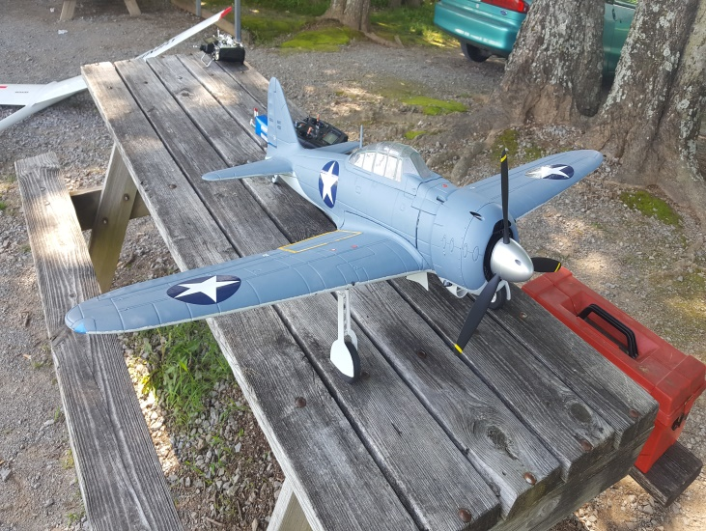
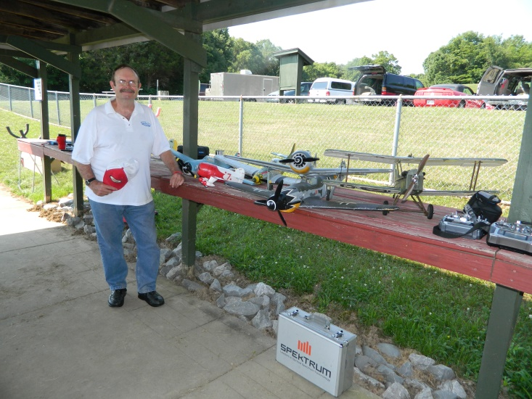
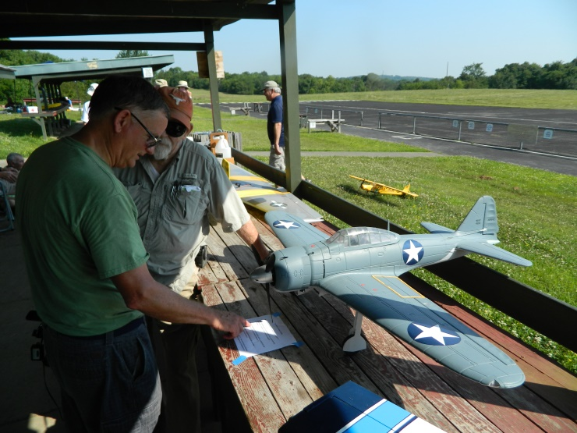
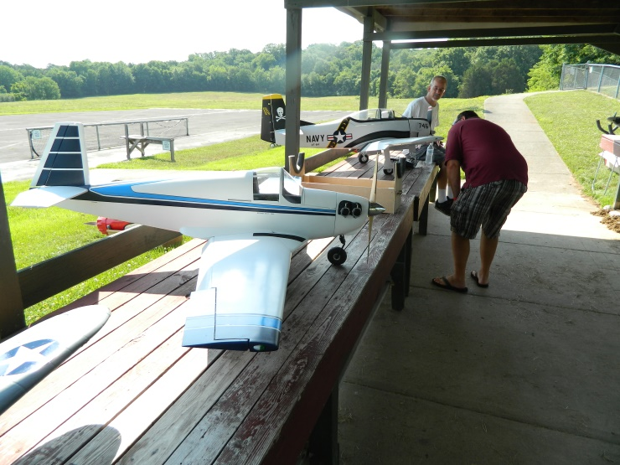
The MCA
Flightline
Member Moments
Check out the new internet home of the Music City Aviators!
www.MusicCityAviators.org

Slide 6
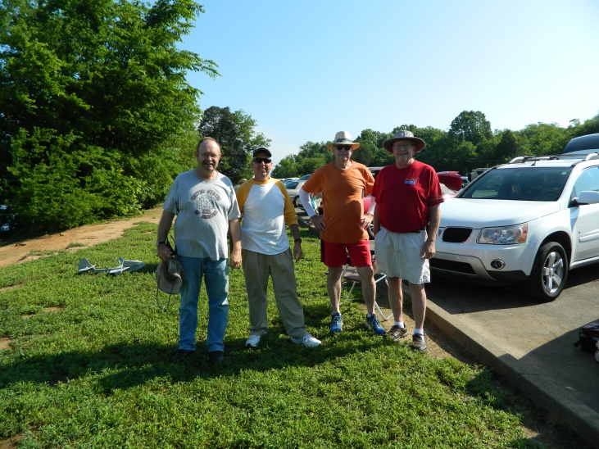
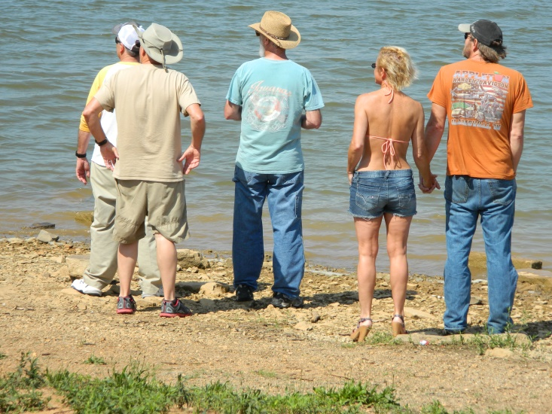
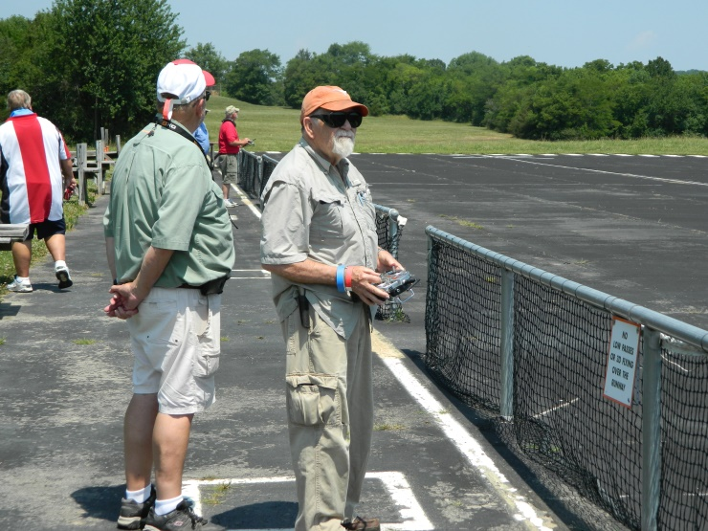
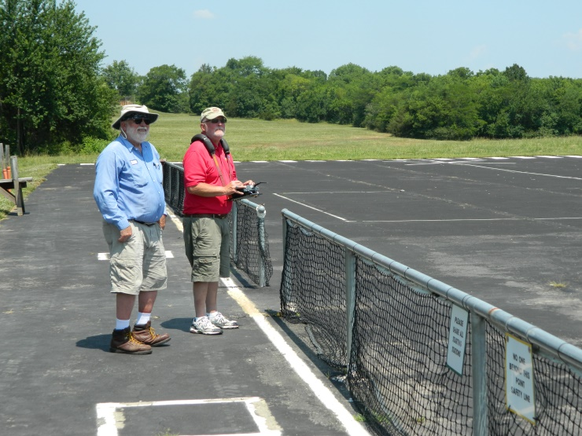
The MCA
Flightline
Member Moments
Check out the new internet home of the Music City Aviators!
www.MusicCityAviators.org

Slide 7
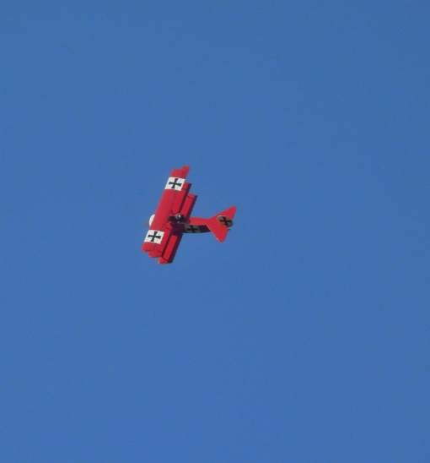
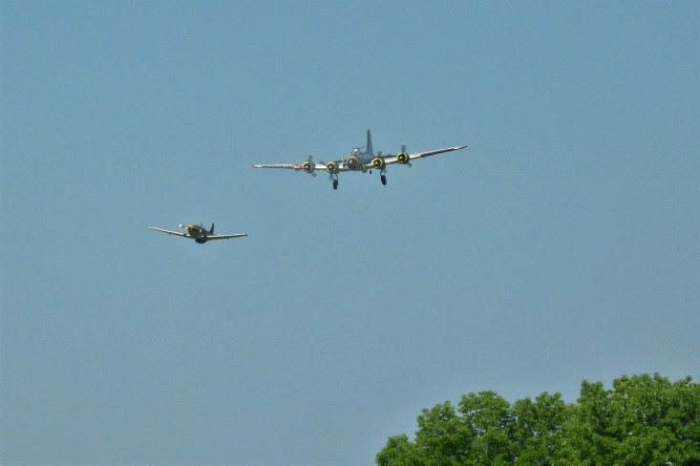
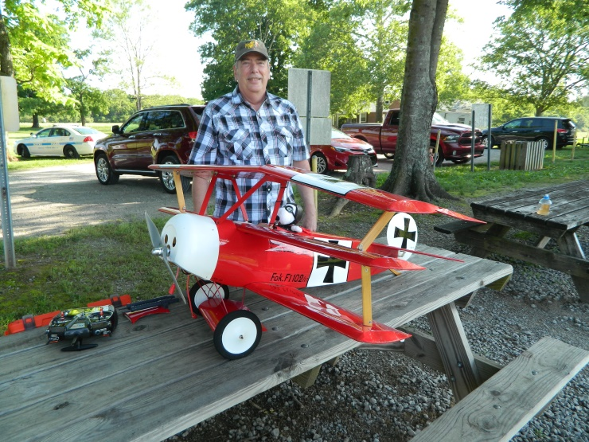
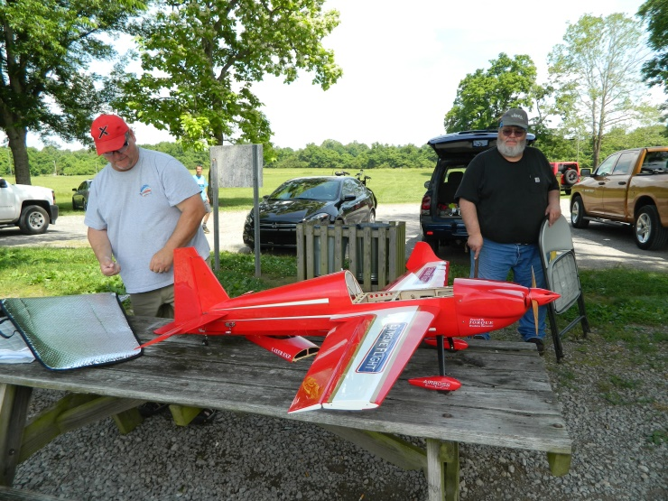
The MCA
Flightline
Member Moments
Check out the new internet home of the Music City Aviators!
www.MusicCityAviators.org

Slide 8
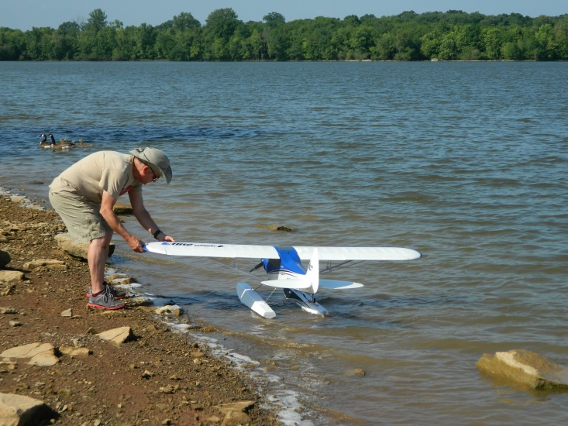
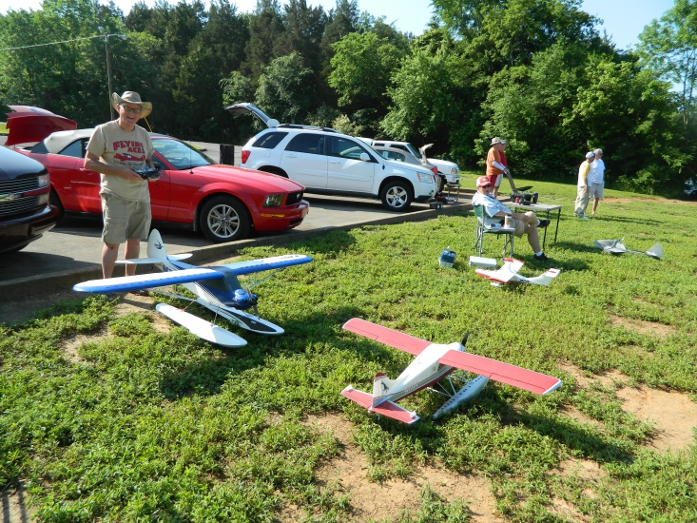
The MCA
Flightline
Member Moments
If you have photos you would like to see in our Newsletter, please
Email them to cwaterston@comcast.net. Thank you.
Check out the new internet home of the Music City Aviators!
www.MusicCityAviators.org

